Slide 1
Net Zero Project (IRCP0024)
Lauren Tuckerman (Adam Smith Business School, University of Glasgow)
Francisco Trincado Munoz (Oxford Brookes Business School, Oxford Brookes University)
Michalis Papazoglou (Oxford Brookes Business School, Oxford Brookes University)
Jakub Janec (Oxford Brookes Business School, Oxford Brookes University)
Tim Vorley (Oxford Brookes Business School, Oxford Brookes University)
01/09/2025

Slide 2
Overarching Question and Approach
Investment - Understand timeseries data that demonstrates what is being invested in in terms of 'green businesses'
Sectors - To understand the ‘attractiveness’ and market penetration of net zero technology
Technologies - To integrate and compare (within limitations) technology types across different measures such as patents, exports and emissions
Focused on those that are involved in some way in “green” innovation
Are growing quickly in sectors related to Net Zero
Are operating in a 'clean' or 'green' industry
Penetration and coalescence with related industries
What is the UK good at in terms of net zero technologies which will return an economic benefit?

Slide 3
Our Method
Reviewed secondary analyses:
Export measures of revealed competitive advantage, complexity and proximity to UK capabilities
Worked with ‘real time’ dataset obtained from Beauhurst’s financial database
Descriptive statistics
Industry space analysis
Technology industry cluster analysis
Technology & equity/grant funding regressions
Patents including revealed technological advantage and expected return on investment

Slide 4

Patent based insights
UK has relative technological advantage in the following Net Zero Technologies:
  tidal stream
  offshore wind
  carbon capture, utilisation and storage (CCUS)
  nuclear technologies
tidal stream and offshore wind energy are likely to generate high levels of economic benefit from government investment
CCUS, smart systems and building fabrics are also providing high levels of return
AI demonstrates a high level of patenting, but currently low levels of return based on patent data from 2005-2014 (Curran et al., 2022).

Slide 5
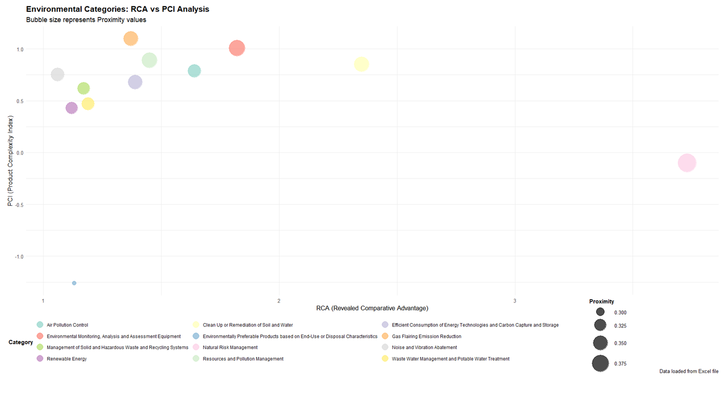
Export based strengths
Environment Monitoring, Analysis and Assessment Equipment – high product complexity
Clean Up or Remediation of Soil and Water – high product complexity & high complexity
Gas Flaring Emission Reduction – high product complexity
Renewable Energy
Natural Risk Management – UK has high comparative advantage
(Data source: Andres & Mealy, 2023)

Slide 6
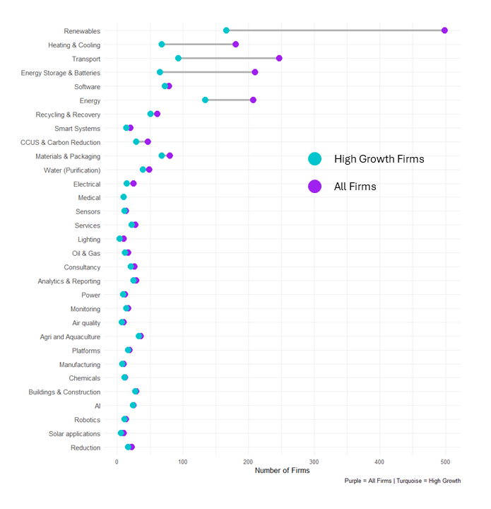
High Growth Firms
(Real Time Data)
A ‘long tail’ distribution
Most of the high growth firms within a small number of Net Zero technology groups
Renewable Energy firms have the highest representation of high growth firms
Distance between the number of high growth firms to all firms is also large
There is a need to understand how to move more of the Renewable Energy firms towards high growth if the UK is seeking to maximise economic benefits from Net Zero technologies.

Slide 7
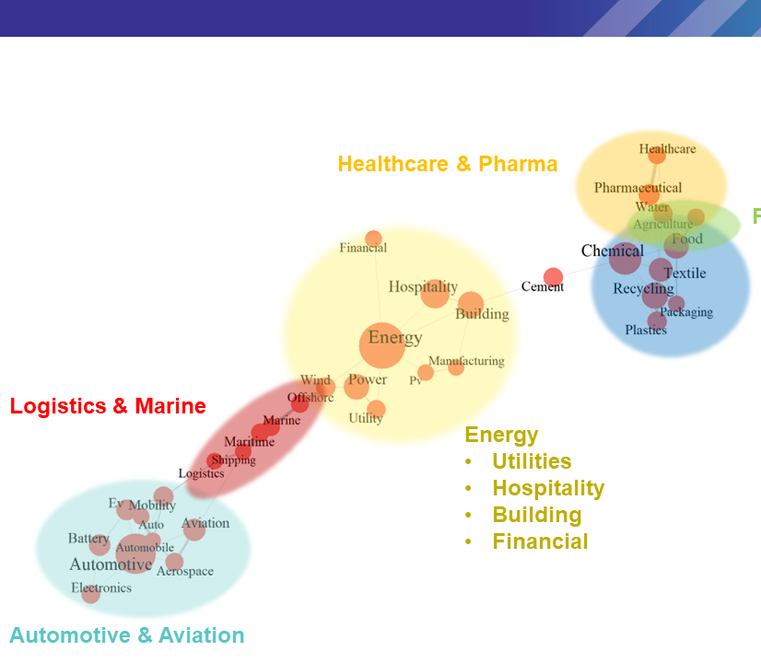
Industry Space Analysis (Real Time Data)
The innovative capacity of Net Zero industries is founded on energy-related businesses
These firms creating strong connections across industries.
Exploring more distant clusters can provide more innovation (i.e. Plastics & Recycling with Automotive and Aviation)

Slide 8
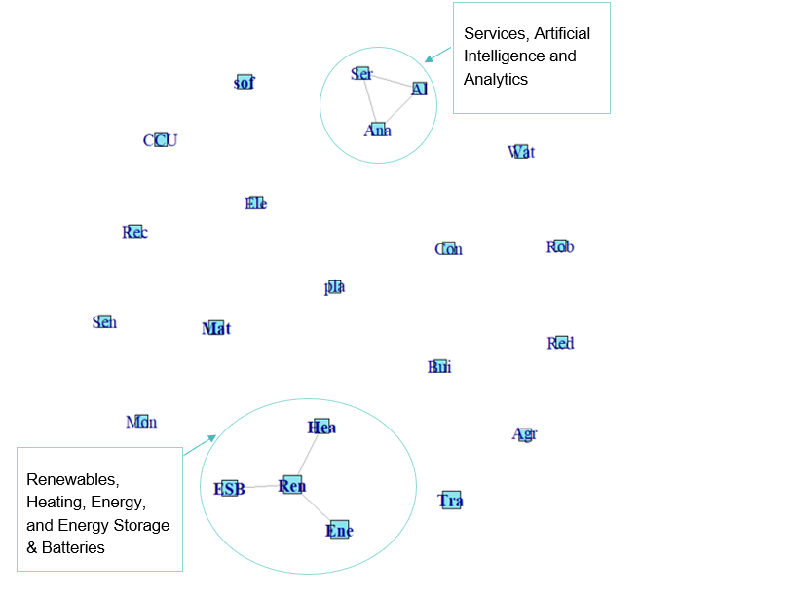
Industry to Technology Cluster Analysis (Real Time Data)
Two clusters appear in this network:
    Renewables, Heating, Energy, and Energy Storage and Batteries
    Services, Artificial Intelligence, and Analytics
Net Zero Technologies tend to remain specialised in their area.
There is scope to supporting firms working on Net Zero technologies in strong siloes to understand the potential to open up technological advances for other industrial applications.
Enabling technologies such as AI and Digital Platforms already have very diverse applications which should cut across industry boundaries
There is a role to support the diffusion of these innovations in firms working on other Net Zero technologies.

Slide 9
Funding & Technology Groups (Real Time Data)
Materials and Packaging technologies have a positive significant relationship to the ability to get equity
Digital Platforms have a positive significant relationship to receiving equity investment
Software has a positive significant relationship with receiving equity investment
Patenting, being a spinout, attending spinout events and participating in accelerators all have a positive statistically significant relationship with the funding metrics proving to be better means of predicting funding
Activities such as patenting, being a spinout, attending spinout events and participation in accelerators act as signals of credibility to investors.
To maximise the potential of Net Zero technologies, and build on what the UK is already good at, targeting Net Zero specific programmes for spinout and accelerators could prove fruitful, particularly if they focus on means of patenting technologies, and export readiness

Slide 10
Overview of findings: Technology Strengths
Strengths in patents: Tidal Stream, Offshore Wind, Carbon Capture, Utilization and Storage (CCUS), Nuclear technologies, Smart systems. Building fabrics
Strengths in exports: Clean up/remediation of soil & water, Environmental monitoring, analysis and assessment, Natural risk management, Gas flaring emissions reduction
Strengths in industry connections: Transport, Energy
Strengths in funding: Materials & Packaging, Digital Platforms, Software

Slide 11
Core Takeaways
There’s little overlap between specific technologies identified as strengths by the different data sources.
However there are two broad areas of strength:
Energy
Monitoring/Software/Consultancy/Analytics
Energy can perhaps be considered more central to the Net Zero technology mission, where some of the other technologies could be considered ‘enabling technologies’
Overall the diffusion of enabling technologies throughout industries covered by Net Zero appears weak
The technology groups we tested against funding types were often negatively associated, meaning that these companies were less likely to get funding.

Slide 12
‘So What’s’
Investment in Net Zero energy technologies has multiple economic benefits depending on which technologies you invest in
There is potential in encouraging adoption of more enabling technologies to Net Zero firms to encourage further efficiencies
Supporting the diversity of Net Zero technologies is challenging, but diversity suggests resilience
Firms may need support to maximise economic opportunity from highly complex, specialized technologies, focused support programmes could target this through readiness to export and patent support

Slide 13
Potential avenues for future research
To explore the relationship between grants and equity funding in Net Zero firms to better understand whether grants attract or replace equity funding in this space
To look at the effect on turnover of particular technologies
To take a deeper dive into Energy to more clearly unpack the different economic benefits of particular technologies
To breakdown technologies by their technology readiness levels to understand potentially which technologies could benefit from what support at different stages of their development.

Slide 14
References
Andres, P and Mealy, P (2023) Green Transition Navigator. Retrieved from www.green-transition-navigator.org
Curran, B., Martin, R., Muller, S., Nguyen-Tien, V., Oliveira-Cunha, J., Serin, E., Shah, A., Valero, A., & Verhoeven, D. (2022). Growing clean: Identifying and investing in sustainable growth opportunities across the UK, The Resolution Foundation, https://economy2030.resolutionfoundation.org/wp-content/uploads/2022/05/Growing_clean_report.pdf

Slide 15


Thank you
Lauren.Tuckerman@glasgow.ac.uk

